Slide 1
Figures – Chapter 18

Slide 2
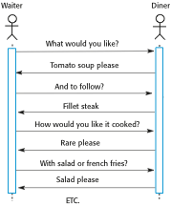
Figure 18.1 Procedural interaction between a diner and a waiter

Slide 3
Figure 18.2 Message-based interaction between a waiter and the kitchen
<starter>
<dish name = “soup” type = “tomato” />
<dish name = “soup” type = “fish” />
<dish name = “pigeon salad” />
</starter>
<main course>
<dish name = “steak” type = “sirloin” cooking = “medium” />
<dish name = “steak” type = “fillet” cooking = “rare” />
<dish name = “sea bass”>
</main>
<accompaniment>
<dish name = “french fries” portions = “2” />
<dish name = “salad” portions = “1” />
</accompaniment>

Slide 4
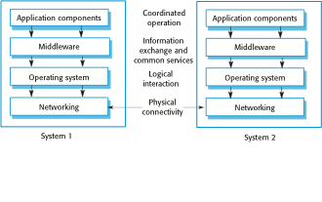
Figure 18.3 Middleware in a distributed system

Slide 5
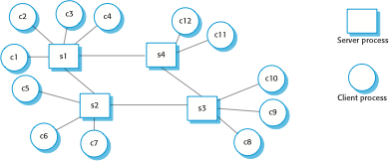
Figure 18.4 Client–server interaction

Slide 6
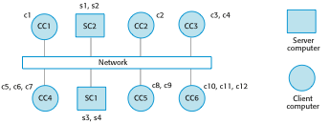
Figure 18.5 Mapping of clients and servers to networked computers

Slide 7
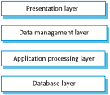
Figure 18.6 Layered architectural model for client–server application

Slide 8
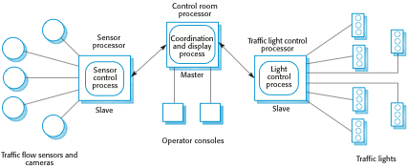
Figure 18.7 A traffic management system with a master-slave architecture

Slide 9
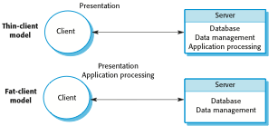
Figure 18.8 Thin- and fat-client architectural models

Slide 10
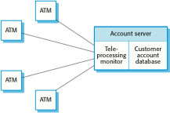
Figure 18.9 A fat-client architecture for an ATM system

Slide 11
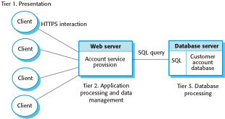
Figure 18.10 Three-tier architecture for an Internet banking system

Slide 12
Figure 18.11 Use of client–server architectural patterns
Architecture | Applications
Two-tier client–server architecture with thin clients | Legacy system applications that are used when separating application processing and data management is impractical. Clients may access these as services, as discussed in Section 18.4. Computationally intensive applications such as compilers with little or no data management. Data-intensive applications (browsing and querying) with nonintensive application processing. Browsing the Web is the most common example of a situation where this architecture is used.
Two-tier client-server architecture with fat clients | Applications where application processing is provided by off-the-shelf software (e.g., Microsoft Excel) on the client. Applications where computationally intensive processing of data (e.g., data visualization) is required. Mobile applications where internet connectivity cannot be guaranteed. Some local processing using cached information from the database is therefore possible.
Multi-tier client–server architecture | Large-scale applications with hundreds or thousands of clients. Applications where both the data and the application are volatile. Applications where data from multiple sources are integrated.

Slide 13
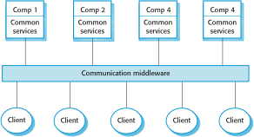
Figure 18.12 A distributed component architecture

Slide 14
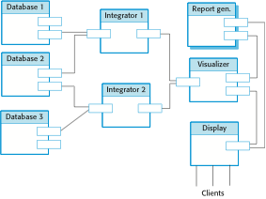
Figure 18.13 A distributed component architecture for a data mining system

Slide 15
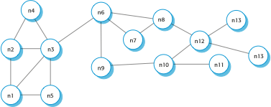
Figure 18.14 A decentralized p2p architecture

Slide 16
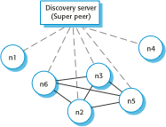
Figure 18.15 A semicentralized p2p architecture

Slide 17
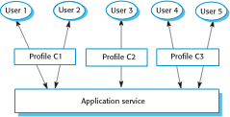
Figure 18.16 Configuration of a software system offered as a service

Slide 18

Figure 18.17 A multitenant database

